Slide 1
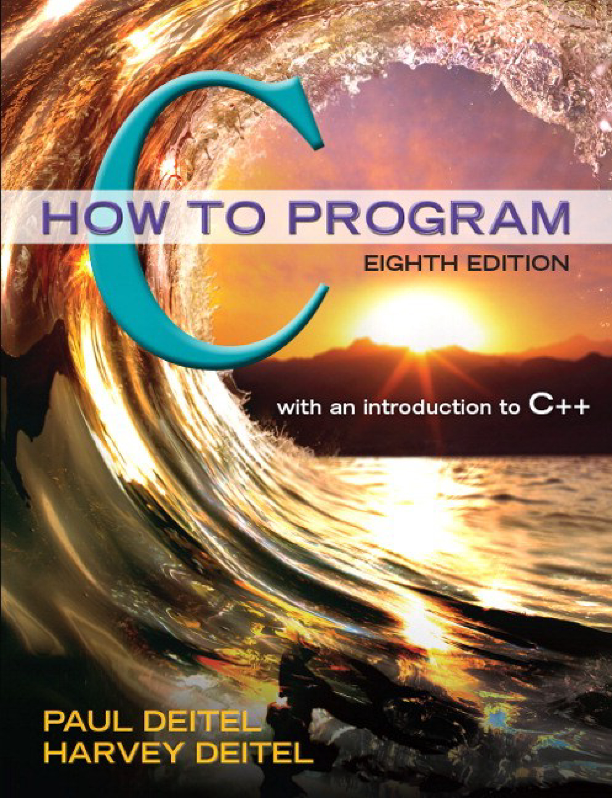
C How to Program
Eighth Edition
Chapter 1
Introduction to Computers, the Internet and the Web
Slides in this presentation contain hyperlinks. JAWS users should be able to get a list of links by using INSERT+F7
Copyright © 2016, 2013, 2010 Pearson Education, Inc. All Rights Reserved
Notes:
If this PowerPoint presentation contains mathematical equations, you may need to check that your computer has the following installed:
1) MathType Plugin
2) Math Player (free versions available)
3) NVDA Reader (free versions available)

Slide 2
Learning Objectives
Basic computer concepts.
The different types of programming languages.
The history of the C programming language.
The purpose of the C Standard Library.
The basics of object technology.
A typical C program development environment.
To test-drive a C application in Windows, Linux and Mac O S X.
Some basics of the Internet and the World Wide Web.

Slide 3
Outline (1 of 5)
1.1 Introduction
1.2 Hardware and Software
1.2.1 Moore’s Law
1.2.2 Computer Organization
1.3 Data Hierarchy
1.4 Machine Languages, Assembly Languages and High-Level Languages
1.5 The C Programming Language
1.6 C Standard Library
1.7 C++ and Other C-Based Languages

Slide 4
Outline (2 of 5)
1.8 Object Technology
1.8.1 The Automobile as an Object
1.8.2 Methods and Classes
1.8.3 Instantiation
1.8.4 Reuse
1.8.5 Messages and Method Calls
1.8.6 Attributes and Instance Variables
1.8.7 Encapsulation and Information Hiding
1.8.8 Inheritance

Slide 5
Outline (3 of 5)
1.9 Typical C Program-Development Environment
1.9.1 Phase 1: Creating a Program
1.9.2 Phases 2 and 3: Preprocessing and Compiling a C Program
1.9.3 Phase 4: Linking
1.9.4 Phase 5: Loading
1.9.5 Phase 6: Execution
1.9.6 Problems That May Occur at Execution Time
1.9.7 Standard Input, Standard Output and Standard Error Streams

Slide 6
Outline (4 of 5)
1.10 Test-Driving a C Application in Windows, Linux and Mac O S X
1.10.1 Running a C Application from the Windows Command Prompt
1.10.2 Running a C Application Using G N U C with Linux
1.10.3 Running a C Application Using the Teminal on Mac O S X
1.11 Operating Systems
1.11.1 Windows—A Proprietary Operating System
1.11.2 Linux—An Open-Source Operating System
1.11.3 Apple’s Mac O S X; Apple’s i O S for iPhone®, iPad® and iPod Touch® Devices
1.11.4 Google’s Android

Slide 7
Outline (5 of 5)
1.12 The Internet and World Wide Web
1.12.1 The Internet: A Network of Networks
1.12.2 The World Wide Web: Making the Internet User-Friendly
1.12.3 Web Services
1.12.4 Ajax
1.12.5 The Internet of Things
1.13 Some Key Software Terminology
1.14 Keeping Up-to-Date with Information Technologies

Slide 8
1.1 Introduction
The core of the book emphasizes effective software engineering through the proven methodologies of structured programming in C and object-oriented programming in C++.
All of these example programs may be downloaded from our website www.deitel.com/books/chtp7/.
You’ll learn how to command computers to perform tasks.
Software (i.e., the instructions you write to command computers to perform actions and make decisions) controls computers (often referred to as hardware).

Slide 9
1.2 Hardware and Software (1 of 3)
Computers can perform calculations and make logical decisions phenomenally faster than human beings can.
Today’s personal computers can perform billions of calculations in one second—more than a human can perform in a lifetime.
Supercomputers are already performing thousands of trillions (quadrillions) of instructions per second!
Computers process data under the control of sequences of instructions called computer programs.
These programs guide the computer through ordered actions specified by people called computer programmers.

Slide 10
1.2 Hardware and Software (2 of 3)
The programs that run on a computer are referred to as software.
A computer consists of various devices referred to as hardware
(e.g., the keyboard, screen, mouse, hard disks, memory, D V D drives and processing units).
Computing costs are dropping dramatically, owing to rapid developments in hardware and software technologies.

Slide 11
1.2 Hardware and Software (3 of 3)
Computers that might have filled large rooms and cost millions of dollars decades ago are now inscribed on silicon chips smaller than a fingernail, costing perhaps a few dollars each.
Silicon-chip technology has made computing so economical that computers have become commodity.

Slide 12
1.2.1 Moore’s Law (1 of 3)
For many decades, hardware costs have fallen rapidly.
Every year or two, the capacities of computers have approximately doubled inexpensively.
This trend often is called Moore’s Law, named for the person who identified it in the 1960s, Gordon Moore, co-founder of Intel.

Slide 13
1.2.1 Moore’s Law (2 of 3)
Moore’s Law and related observations apply especially to the amount of memory that computers have for programs, the amount of secondary storage (such as disk storage) they have to hold programs and data over longer periods of time, and their processor speeds—the speeds at which computers execute their programs (i.e., do their work).
Similar growth has occurred in the communications field.

Slide 14
1.2.1 Moore’s Law (3 of 3)
Costs have plummeted as enormous demand for communications bandwidth (i.e., information-carrying capacity) has attracted intense competition.
Such phenomenal improvement is fostering the Information Revolution.

Slide 15
1.2.2 Computer Organization
Regardless of differences in physical appearance, computers can be envisioned as divided into various logical units or sections (Figure 1.1)

Slide 16
Figure 1.1 Logical Units of a Computer (1 of 5)
Logical unit | Description
Input unit | This “receiving” section obtains information (data and computer programs) from input devices and places it at the disposal of the other units for processing. Most user input is entered into computers through keyboards, touch screens and mouse devices. Other forms of input include receiving voice commands, scanning images and barcodes, reading from secondary storage devices (such as hard drives, D V D drives, Blu-ray Disc™ drives and U S B flash drives—also called “thumb drives” or “memory sticks”), receiving video from a webcam and having your computer receive information from the Internet (such as when you stream videos from YouTube® or download e-books from Amazon). Newer forms of input include position data from a G P S device, and motion and orientation information from an accelerometer (a device that responds to up/down, left/right and forward/backward acceleration) in a smartphone or game controller (such as Microsoft® Kinect® for Xbox®, Wii™ Remote and Sony® PlayStation® Move).

Slide 17
Figure 1.1 Logical Units of a Computer (2 of 5)
Logical unit | Description
Output unit | This “shipping” section takes information the computer has processed and places it on various output devices to make it available for use outside the computer. Most information that’s output from computers today is displayed on screens (including touch screens), printed on paper (“going green” discourages this), played as audio or video on P C s and media players (such as Apple’s iPods) and giant screens in sports stadiums, transmitted over the Internet or used to control other devices, such as robots and “intelligent” appliances. Information is also commonly output to secondary storage devices, such as hard drives, D V D drives and U S B flash drives. Popular recent forms of output are smartphone and game controller vibration, and virtual reality devices like Oculus Rift.

Slide 18
Figure 1.1 Logical Units of a Computer (3 of 5)
Logical unit | Description
Memory unit | This rapid-access, relatively low-capacity “warehouse” section retains information that has been entered through the input unit, making it immediately available for processing when needed. The memory unit also retains processed information until it can be placed on output devices by the output unit. Information in the memory unit is volatile—it’s typically lost when the computer’s power is turned off. The memory unit is often called either memory, primary memory or RAM (Random Access Memory). Main memories on desktop and notebook computers contain as much as 128 G B of RAM, though 2 to 16 G B is most common. G B stands for gigabytes; a gigabyte is approximately one billion bytes. A byte is eight bits. A bit is either a 0 or a 1.

Slide 19
Figure 1.1 Logical Units of a Computer (4 of 5)
Logical unit | Description
Arithmetic and logic unit (A L U) | This “manufacturing” section performs calculations, such as addition, subtraction, multiplication and division. It also contains the decision mechanisms that allow the computer, for example, to compare two items from the memory unit to determine whether they’re equal. In today’s systems, the A L U is implemented as part of the next logical unit, the C P U.
Central processing unit (C P U) | This “administrative” section coordinates and supervises the operation of the other sections. The C P U tells the input unit when information should be read into the memory unit, tells the A L U when information from the memory unit should be used in calculations and tells the output unit when to send information from the memory unit to certain output devices. Many of today’s computers have multiple C P Us and, hence, can perform many operations simultaneously. A multi-core processor implements multiple processors on a single integrated-circuit chip—a dual-core processor has two C P U s and a quadcore processor has four C P Us. Today’s desktop computers have processors that can execute billions of instructions per second.

Slide 20
Figure 1.1 Logical Units of a Computer (5 of 5)
Logical unit | Description
Secondary storage unit | This is the long-term, high-capacity “warehousing” section. Programs or data not actively being used by the other units normally are placed on secondary storage devices (e.g., your hard drive) until they’re again needed, possibly hours, days, months or even years later. Information on secondary storage devices is persistent—it’s preserved even when the computer’s power is turned off. Secondary storage information takes much longer to access than information in primary memory, but its cost per unit is much less. Examples of secondary storage devices include hard drives, D V D drives and U S B flash drives, some of which can hold over 2 T B (TB stands for terabytes; a terabyte is approximately one trillion bytes). Typical hard drives on desktop and notebook computers hold up to 2 T B, and some desktop hard drives can hold up to 6 T B.

Slide 21
1.3 Data Hierarchy (1 of 6)
Data items processed by computers form a data hierarchy that becomes larger and more complex in structure as we progress from bits to characters to fields, and so on.

Slide 22
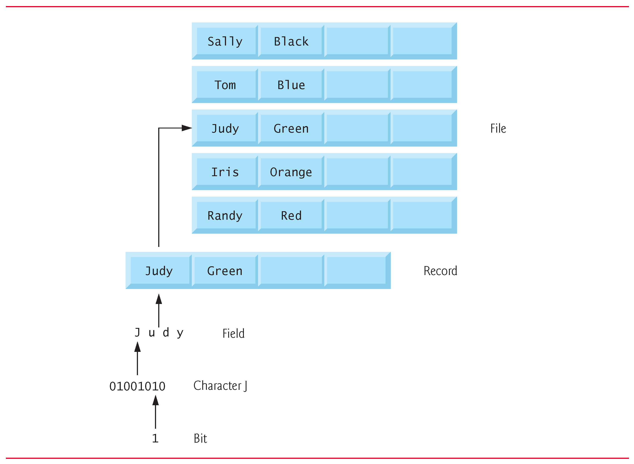
Figure 1.2 Data Hierarchy

Slide 23
1.3 Data Hierarchy (2 of 6)
Bits
The smallest data item in a computer can assume the value 0 or the value 1.
Short for “binary digit”—a digit that can assume one of two values.
Characters
It’s tedious for people to work with data in the low-level form of bits

Slide 24
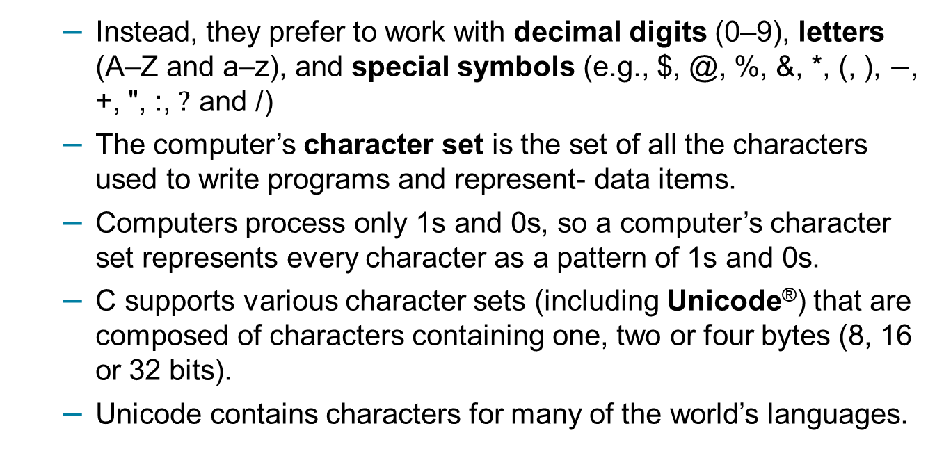
1.3 Data Hierarchy (3 of 6)
Instead, they prefer to work with decimal digits (0–9), letters (A–Z and a–z), and special symbols (e.g., $, @, %, &, *, (, ), $−$, +, ", :, $?$ and /)
The computer’s character set is the set of all the characters used to write programs and represent- data items.
Computers process only 1s and 0s, so a computer’s character set represents every character as a pattern of 1s and 0s.
C supports various character sets (including Unicode®) that are composed of characters containing one, two or four bytes (8, 16 or 32 bits).
Unicode contains characters for many of the world’s languages.

Slide 25
1.3 Data Hierarchy (4 of 6)
Fields
Composed of characters or bytes.
A field is a group of characters or bytes that conveys meaning.
Records
Several related fields can be used to compose a record—a group of related fields.

Slide 26
1.3 Data Hierarchy (5 of 6)
File
A group of related records.
More generally, a file contains arbitrary data in arbitrary formats.
In some operating systems, a file is viewed simply as a sequence of bytes—any organization of the bytes in a file, such as organizing the data into records, is a view created by the application programmer.
Database
A database is a collection of data organized for easy access and manipulation.

Slide 27
1.3 Data Hierarchy (6 of 6)
The most popular model is the relational database, in which data is stored in simple tables.
A table includes records and fields.
You can search, sort and otherwise manipulate the data based on its relationship to multiple tables or databases.
Big Data
According to I B M, approximately 2.5 quintillion bytes (2.5 exabytes) of data are created daily and 90% of the world’s data was created in just the past two years
According to an I D C study, the global data supply will reach 40 zettabytes (equal to 40 trillion gigabytes) annually by 2020.
Big data applications deal with massive amounts of data

Slide 28
Figure 1.3 Byte Measurements
Unit | Bytes | Which is approximately
1 kilobyte (K B) | 1024 bytes | 10 power 3 (1024 bytes exactly)
1 megabyte (M B) | 1024 kilobytes | 10 power 6 (1,000,000 bytes)
1 gigabyte (G B) | 1024 megabytes | 10 power 9 (1,000,000,000 bytes)
1 terabyte (T B) | 1024 gigabytes | 10 power 12 (1,000,000,000,000 bytes)
1 petabyte (P B) | 1024 terabytes | 10 power 15 (1,000,000,000,000,000 bytes)
1 exabyte (E B) | 1024 petabytes | 10 power 18 (1,000,000,000,000,000,000 bytes)
1 zettabyte (Z B) | 1024 exabytes | 10 power 21 (1,000,000,000,000,000,000,000 bytes)

Slide 29
1.4 Machine Languages, Assembly Languages and High-Level Languages (1 of 3)
Programmers write instructions in various programming languages, some directly understandable by computers and others requiring intermediate translation steps.
Any computer can directly understand only its own machine language, defined by its hardware design.
Machine languages generally consist of numbers (ultimately reduced to 1s and 0s). Such languages are cumbersome for humans.
Programming in machine language—the numbers that computers could directly understand—was simply too slow and tedious for most programmers.
Instead, they began using English like abbreviations to represent elementary operations.

Slide 30
1.4 Machine Languages, Assembly Languages and High-Level Languages (2 of 3)
These abbreviations formed the basis of assembly languages.
Translator programs called assemblers were developed to convert assembly-language programs to machine language.
Although assembly-language code is clearer to humans, it’s incomprehensible to computers until translated to machine language.
To speed the programming process even further, high-level languages were developed in which single statements could be written to accomplish substantial tasks.
High-level languages allow you to write instructions that look almost like everyday English and contain commonly used mathematical expressions.

Slide 31
1.4 Machine Languages, Assembly Languages and High-Level Languages (3 of 3)
Translator programs called compilers convert high-level language programs into machine language.
Interpreter programs were developed to execute high-level language programs directly, although more slowly than compiled programs.
Scripting languages such as JavaScript and P H P are processed by interpreters.

Slide 32
1.5 The C Programming Language (1 of 3)
C evolved from two previous languages, B C P L and B.
B C P L was developed in 1967 by Martin Richards as a language for writing operating-systems software and compilers.
Ken Thompson modeled many features in his B language after their counterparts in B C P L, and in 1970 he used B to create early versions of the UNIX operating system at Bell Laboratories.

Slide 33
1.5 The C Programming Language (2 of 3)
The C language was evolved from B by Dennis Ritchie at Bell Laboratories and was originally implemented in 1972.
C initially became widely known as the development language of the UNIX operating system.
Many of todays leading operating systems are written in C and/or C++.
C is mostly hardware independent.
With careful design, it’s possible to write C programs that are portable to most computers.

Slide 34
1.5 The C Programming Language (3 of 3)
Built for Performance
C is widely used to develop systems that demand performance, such as operating systems, embedded systems, real-time systems and communications systems (Figure 1.4).

Slide 35
Figure 1.4 Some Popular Performance-Oriented C Applications (1 of 2)
Application | Description
Operating systems | C’s portability and performance make it desirable for implementing operating systems, such as Linux and portions of Microsoft’s Windows and Google’s Android. Apple’s O S X is built in Objective-C, which was derived from C. We discuss some key popular desktop/notebook operating systems and mobile operating systems in Section 1.11.
Embedded systems | The vast majority of the microprocessors produced each year are embedded in devices other than general-purpose computers. These embedded systems include navigation systems, smart home appliances, home security systems, smartphones, tablets, robots, intelligent traffic intersections and more. C is one of the most popular programming languages for developing embedded systems, which typically need to run as fast as possible and conserve memory. For example, a car’s antilock brakes must respond immediately to slow or stop the car without skidding; game controllers used for video games should respond instantaneously to prevent any lag between the controller and the action in the game, and to ensure smooth animations.

Slide 36
Figure 1.4 Some Popular Performance-Oriented C Applications (2 of 2)
Application | Description
Real-time systems | Real-time systems are often used for “mission-critical” applications that require nearly instantaneous and predictable response times. Real-time systems need to work continuously for example, an air-traffic-control system must constantly monitor the positions and velocities of the planes and report that information to air-traffic controllers without delay so that they can alert the planes to change course if there’s a possibility of a collision.
Communications systems | Communications systems need to route massive amounts of data to their destinations quickly to ensure that things such as audio and video are delivered smoothly and without delay.

Slide 37
Portability Tip 1.1
Because C is a hardware-independent, widely available language, applications written in C often can run with little or no modification on a wide range of computer systems.

Slide 38
1.6 C Standard Library (1 of 3)
As you’ll learn in Chapter 5, C programs consist of pieces called functions.
You can program all the functions you need to form a C program, but most C programmers take advantage of the rich collection of existing functions called the C Standard Library.
Visit the following website for the C Standard Library documentation: www.dinkumware.com/manuals/#Standard%20C%20Library
This textbook encourages a building-block approach to creating programs.

Slide 39
1.6 C Standard Library (2 of 3)
Avoid reinventing the wheel.
Instead, use existing pieces—this is called software reuse.
When programming in C you’ll typically use the following building blocks:
C Standard Library functions
Functions you create yourself
Functions other people (whom you trust) have created and made available to you

Slide 40
1.6 C Standard Library (3 of 3)
The advantage of creating your own functions is that you’ll know exactly how they work. You’ll be able to examine the C code.
The disadvantage is the time-consuming effort that goes into designing, developing and debugging new functions.

Slide 41
Performance Tip 1.1
Using C Standard Library functions instead of writing your own versions can improve program performance, because these functions are carefully written to perform efficiently.

Slide 42
Portability Tip 1.2
Using C Standard Library functions instead of writing your own comparable versions can improve program portability, because these functions are used in virtually all Standard C implementations.

Slide 43
1.7 C++ and Other C-Based Languages (1 of 2)
C++ was developed by Bjarne Stroustrup at Bell Laboratories.
It has its roots in C, providing a number of features that “spruce up” the C language.
More important, it provides capabilities for object-oriented programming.
Objects are essentially reusable software components that model items in the real world.
Using a modular, object-oriented design and implementation approach can make software development groups more productive.

Slide 44
1.7 C++ and Other C-Based Languages (2 of 2)
Chapters 15-23 present a condensed treatment of C++ selected from our book C++ How to Program, 9/e.
Figure 1.5 introduces several other popular C-base dprogramming languages.

Slide 45
Figure 1.5 Popular C-Based Programming Languages (1 of 3)
Programming language | Description
Objective-C | Objective-C is an object-oriented language based on C. It was developed in the early 1980s and later acquired by N e X T, which in turn was acquired by Apple. It has become the key programming language for the O S X operating system and all i O S-powered devices (such as i Pods, i Phones and i Pads).
Java | Sun Microsystems in 1991 funded an internal corporate research project which resulted in the C++-based object-oriented programming language called Java. A key goal of Java is to enable the writing of programs that will run on a broad variety of computer systems and computer-controlled devices. This is sometimes called “write once, run anywhere.” Java is used to develop large-scale enterprise applications, to enhance the functionality of web servers (the computers that provide the content we see in our web browsers), to provide applications for consumer devices (smartphones, television set-top boxes and more) and for many other purposes. Java is also the language of Android app development.

Slide 46
Figure 1.5 Popular C-Based Programming Languages (2 of 3)
Programming language | Description
C hash | Microsoft’s three primary object-oriented programming languages are Visual Basic (based on the original Basic), Visual C++ (based on C++) and Visual C hash (based on C++ and Java, and developed for integrating the Internet and the web into computer applications). Non-Microsoft versions of C hash are also available.
P H P | P H P, an object-oriented, open-source scripting language supported by a community of users and developers, is used by millions of websites. P H P is platform independent—implementations exist for all major UNIX, Linux, Mac and Windows operating systems. P H P also supports many databases, including the popular open-source My S Q L.
Python | Python, another object-oriented scripting language, was released publicly in 1991. Developed by Guido van Rossum of the National Research Institute for Mathematics and Computer Science in Amsterdam (C W I), Python draws heavily from Modula-3—a systems programming language. Python is “extensible”—it can be extended through classes and programming interfaces.

Slide 47
Figure 1.5 Popular C-Based Programming Languages (3 of 3)
Programming language | Description
JavaScript | JavaScript is the most widely used scripting language. It’s primarily used to add dynamic behavior to web pages—for example, animations and improved interactivity with the user. It’s provided with all major web browsers.
Swift | Swift, Apple’s new programming language for developing i O S and Mac apps, was announced at the Apple World Wide Developer Conference (W W D C) in June 2014. Although apps can still be developed and maintained with Objective-C, Swift is Apple’s app-development language of the future. It’s a modern language that eliminates some of the complexity of Objective-C, making it easier for beginners and those transitioning from other high-level languages such as Java, C hash, C++ and C. Swift emphasizes performance and security, and has full access to the i O S and Mac programming capabilities.

Slide 48
1.8 Object Technology (1 of 13)
Objects, or more precisely the classes objects come from, are essentially reusable software components.
Almost any noun can be reasonably represented as a software object in terms of attributes (e.g., name, color and size) and behaviors (e.g., calculating, moving and communicating).
Software developers are discovering that using a modular, object-oriented design and implementation approach can make software-development groups much more productive than was possible with earlier techniques—object-oriented programs are often easier to understand, correct and modify.

Slide 49
1.8 Object Technology (2 of 13)
The Automobile as an Object
Suppose you want to drive a car and make it go faster by pressing its accelerator pedal.
Before you can drive a car, someone has to design it.
A car typically begins as engineering drawings, similar to the blueprints that describe the design of a house.
These drawings include the design for an accelerator pedal.

Slide 50
1.8 Object Technology (3 of 13)
The pedal hides from the driver the complex mechanisms that actually make the car go faster, just as the brake pedal hides the mechanisms that slow the car, and the steering wheel hides the mechanisms that turn the car.
This enables people with little or no knowledge of how engines, braking and steering mechanisms work to drive a car easily.
Before you can drive a car, it must be built from the engineering drawings that describe it.
A completed car has an actual accelerator pedal to make the car go faster, but even that’s not enough—the car won’t accelerate on its own (hopefully!), so the driver must press the pedal to accelerate the car.

Slide 51
1.8 Object Technology (4 of 13)
Methods and Classes
Performing a task in a program requires a method.
The method houses the program statements that actually perform its tasks.
It hides these statements from its user, just as a car’s accelerator pedal hides from the driver the mechanisms of making the car go faster.
In object-oriented programming languages, we create a program unit called a class to house the set of methods that perform the class’s tasks.

Slide 52
1.8 Object Technology (5 of 13)
For example, a class that represents a bank account might contain one method to deposit money to an account, another to withdraw money from an account and a third to inquire what the account’s current balance is.
A class is similar in concept to a car’s engineering drawings, which house the design of an accelerator pedal, steering wheel, and so on.

Slide 53
1.8 Object Technology (6 of 13)
Instantiation
Just as someone has to build a car from its engineering drawings before you can actually drive a car, you must build an object from a class before a program can perform the tasks that the class’s methods define.
The process of doing this is called instantiation. An object is then referred to as an instance of its class.

Slide 54
1.8 Object Technology (7 of 13)
Reuse
Just as a car’s engineering drawings can be reused many times to build many cars, you can reuse a class many times to build many objects.
Reuse of existing classes when building new classes and programs saves time and effort.
Reuse also helps you build more reliable and effective systems, because existing classes and components often have gone through extensive testing, debugging and performance tuning.

Slide 55
1.8 Object Technology (8 of 13)
Messages and Method Calls
When you drive a car, pressing its gas pedal sends a message to the car to perform a task—that is, to go faster. Similarly, you send messages to an object.
Each message is implemented as a method call that tells a method of the object to perform its task.
For example, a program might call a particular bank-account object’s deposit method to increase the account’s balance.

Slide 56
1.8 Object Technology (9 of 13)
Attributes and Instance Variables
A car, besides having capabilities to accomplish tasks, also has attributes, such as its color, its number of doors, the amount of gas in its tank, its current speed and its record of total miles driven (i.e., its odometer reading).
Like its capabilities, the car’s attributes are represented as part of its design in its engineering diagrams (which, for example, include an odometer and a fuel gauge).
As you drive an actual car, these attributes are carried along with the car.

Slide 57
1.8 Object Technology (10 of 13)
Every car maintains its own attributes.
For example, each car knows how much gas is in its own gas tank, but not how much is in the tanks of other cars.
An object, similarly, has attributes that it carries along as it’s used in a program.

Slide 58
1.8 Object Technology (11 of 13)
These attributes are specified as part of the object’s class.
For example, a bank-account object has a balance attribute that represents the amount of money in the account.
Each bank-account object knows the balance in the account it represents, but not the balances of the other accounts in the bank.
Attributes are specified by the class’s instance variables.

Slide 59
1.8 Object Technology (12 of 13)
Encapsulation
Classes encapsulate (i.e., wrap) attributes and methods into objects—an object’s attributes and methods are intimately related.
Objects may communicate with one another, but normally they’re not allowed to know how other objects are implemented—implementation details are hidden within the objects themselves.
This information hiding is crucial to good software engineering.

Slide 60
1.8 Object Technology (13 of 13)
Inheritance
A new class of objects can be created quickly and conveniently by inheritance—the new class absorbs the characteristics of an existing class, possibly customizing them and adding unique characteristics of its own.
In our car analogy, an object of class “convertible” certainly is an object of the more general class “automobile,” but more specifically, the roof can be raised or lowered.

Slide 61
Software Engineering Observation 1.1
Use a building-block approach to creating your programs. Avoid reinventing the wheel—use existing high-quality pieces wherever possible. Such software reuse is a key benefit of object-oriented programming.

Slide 62
1.9 Typical C Program Development Environment (1 of 2)
C systems generally consist of several parts: a program development environment, the language and the C Standard Library.
C programs typically go through six phases to be executed
These are: edit, preprocess, compile, link, load and execute.
Although C How to Program, 7/e is a generic C textbook (written independently of the details of any particular operating system), we concentrate in this section on a typical Linux-based C system.

Slide 63
1.9 Typical C Program Development Environment (2 of 2)
[Note: The programs in this book will run with little or no modification on most current C systems, including Microsoft Windows-based systems.] If you’re not using a Linux system, refer to the manuals for your system or ask your instructor how to accomplish these tasks in your environment.
Check out our C Resource Center at www.deitel.com/C to locate “getting started” tutorials for popular C compilers and development environments.

Slide 64
1.9 Phase 1: Creating a Program
Phase 1 consists of editing a file.
This is accomplished with an editor program.
Two editors widely used on Linux systems are vi and emacs.
Software packages for the C/C++ integrated program development environments such as Eclipse and Microsoft Visual Studio have editors that are integrated into the programming environment.
You type a C program with the editor, make corrections if necessary, then store the program on a secondary storage device such as a hard disk.
C program file names should end with the .c extension.

Slide 65
1.9 Phases 2 and 3: Preprocessing and Compiling a C Program (1 of 2)
In Phase 2, the you give the command to compile the program.
The compiler translates the C program into machine language-code (also referred to as object code).
In a C system, a preprocessor program executes automatically before the compiler’s translation phase begins.
The C preprocessor obeys special commands called preprocessor directives, which indicate that certain manipulations are to be performed on the program before compilation.

Slide 66
1.9 Phases 2 and 3: Preprocessing and Compiling a C Program (2 of 2)
These manipulations usually consist of including other files in the file to be compiled and performing various text replacements.
The most common preprocessor directives are discussed in the early chapters; a detailed discussion of preprocessor features appears in Chapter 13.
In Phase 3, the compiler translates the C program into machine-language code.
A syntax error occurs when the compiler cannot recognize a statement because it violates the rules of the language.
Syntax errors are also called compile errors, or compile-time errors.

Slide 67
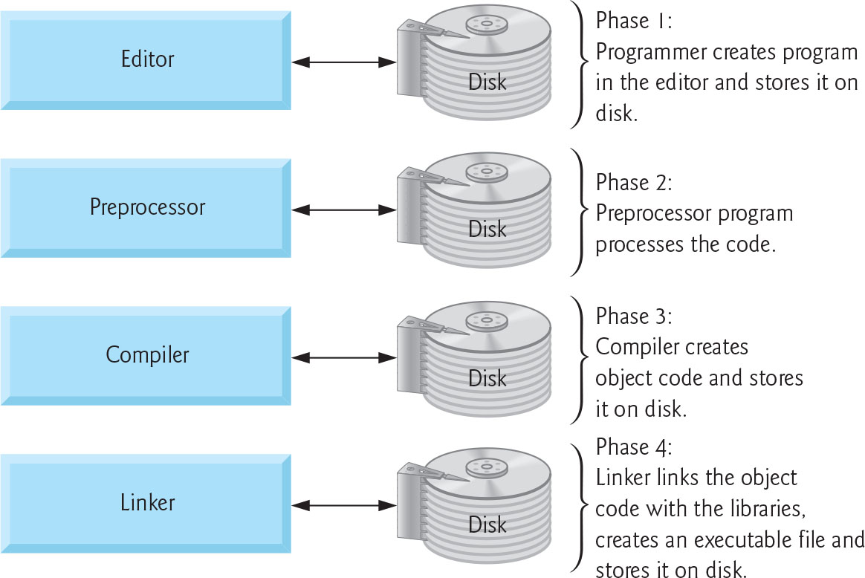
Figure 1.6 Typical C Development Environment (1 of 2)

Slide 68
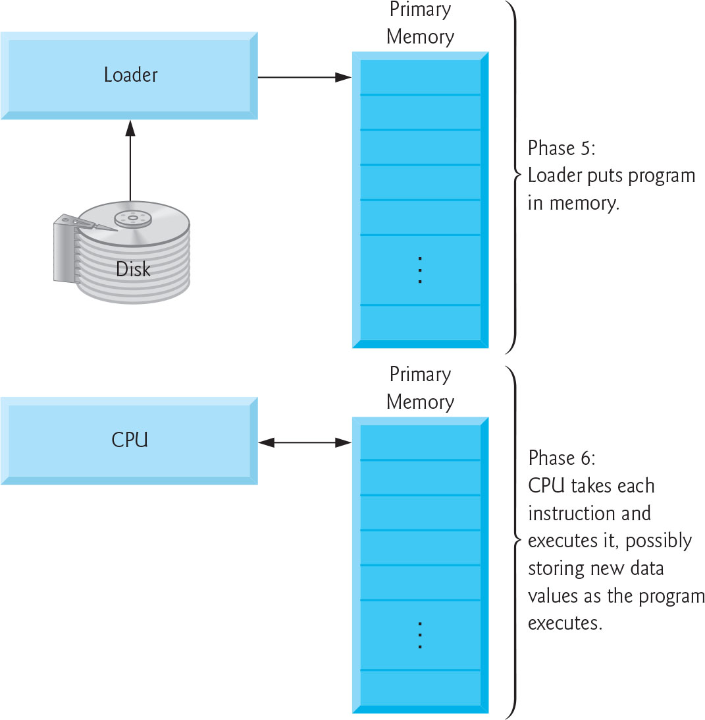
Figure 1.6 Typical C Development Environment (2 of 2)

Slide 69
1.9 Phase 4: Linking (1 of 2)
The next phase is called linking.
C programs typically contain references to functions defined elsewhere, such as in the standard libraries or in the private libraries of groups of programmers working on a particular project.
The object code produced by the C compiler typically contains “holes” due to these missing parts.
A linker links the object code with the code for the missing functions to produce an executable image (with no missing pieces).
On a typical Linux system, the command to compile and link a program is called g c c (the G N U compiler).

Slide 70

1.9 Phase 4: Linking (2 of 2)
To compile and link a program named welcome.c type
at the Linux prompt and press the Enter key (or Return key).
[Note: Linux commands are case sensitive; make sure that each c is lowercase and that the letters in the filename are in the appropriate case.]
If the program compiles and links correctly, a file called a.out is produced.
This is the executable image of our welcome.c program.

Slide 71
1.9 Phase 5: Loading
The next phase is called loading.
Before a program can be executed, the program must first be placed in memory.
This is done by the loader, which takes the executable image from disk and transfers it to memory.
Additional components from shared libraries that support the program are also loaded.

Slide 72
1.9 Phase 6: Execution
Finally, the computer, under the control of its C P U, executes the program one instruction at a time.
To load and execute the program on a Linux system, type ./a.out at the Linux prompt and press Enter.

Slide 73
1.9 Problems That May Occur at Execution Time
Programs do not always work on the first try.
Each of the preceding phases can fail because of various errors that we’ll discuss.
For example, an executing program might attempt to divide by zero (an illegal operation on computers just as in arithmetic).
This would cause the computer to display an error message.
You would then return to the edit phase, make the necessary corrections and proceed through the remaining phases again to determine that the corrections work properly.

Slide 74
Common Programming Error 1.1
Errors such as division-by-zero occur as a program runs, so they are called runtime errors or execution-time errors. Divide-by-zero is generally a fatal error, i.e., one that causes the program to terminate immediately without successfully performing its job. Nonfatal errors allow programs to run to completion, often producing incorrect results.

Slide 75
1.9 Standard Input, Standard Output and Standard Error Streams (1 of 2)
Most C programs input and/or output data.
Certain C functions take their input from stdin (the standard input stream), which is normally the keyboard, but stdin can be connected to another stream.
Data is often output to stdout (the standard output stream), which is normally the computer screen, but stdout can be connected to another stream.
When we say that a program prints a result, we normally mean that the result is displayed on a screen.

Slide 76
1.9 Standard Input, Standard Output and Standard Error Streams (2 of 2)
Data may be output to devices such as disks and printers.
There is also a standard error stream referred to as stderr.
The stderr stream (normally connected to the screen) is used for displaying error messages.
It’s common to route regular output data, i.e., stdout, to a device other than the screen while keeping stderr assigned to the screen so that the user can be immediately informed of errors.

Slide 77
1.10 Test-Driving a C Application in Windows, Linux and Mac O S X (1 of 2)
In this section, you’ll run and interact with your first C application.
You’ll begin by running an entertaining guess-the-number game, which picks a number from 1 to 1000 and prompts you to guess it.
If your guess is correct, the game ends.
If your guess is not correct, the application indicates whether your guess is higher or lower than the correct number. There is no limit on the number of guesses you can make.

Slide 78
1.10 Test-Driving a C Application in Windows, Linux and Mac O S X (2 of 2)
For this test-drive only, we’ve modified this application from the exercise you’ll be asked to create in Chapter 5.
Normally this application randomly selects the correct answers.
The modified application uses the same sequence of correct answers every time you execute the program (though this may vary by compiler), so you can use the same guesses we use in this section and see the same results.

Slide 79
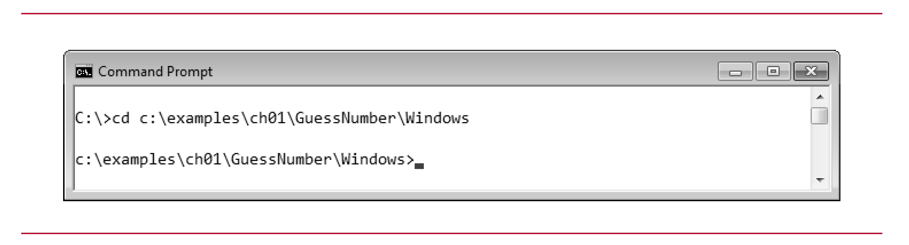
1.10.1 Running a C Application from the Windows Command Prompt (1 of 7)
Figure 1.7 Opening a Command Prompt window and changing the directory.

Slide 80
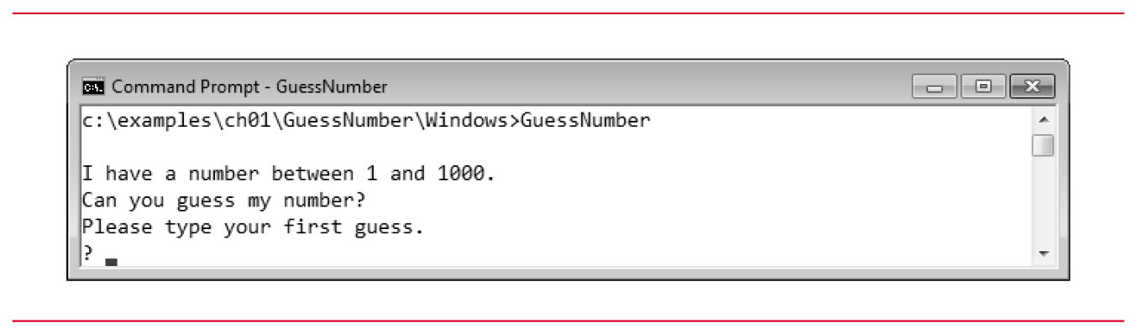
1.10.1 Running a C Application from the Windows Command Prompt (2 of 7)
Figure 1.8 Running the GuessNumber application.

Slide 81
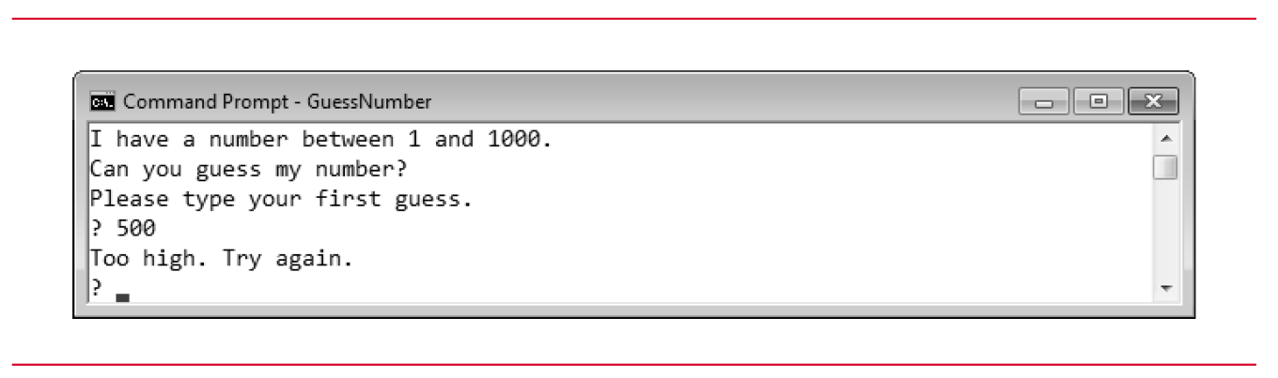
1.10.1 Running a C Application from the Windows Command Prompt (3 of 7)
Figure 1.9 Entering your first guess.

Slide 82
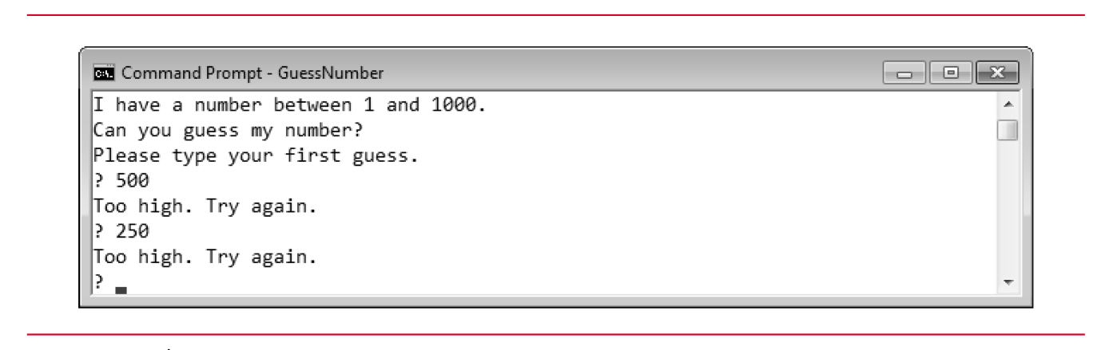
1.10.1 Running a C Application from the Windows Command Prompt (4 of 7)
Figure 1.10 Entering a second guess and receiving feedback.

Slide 83
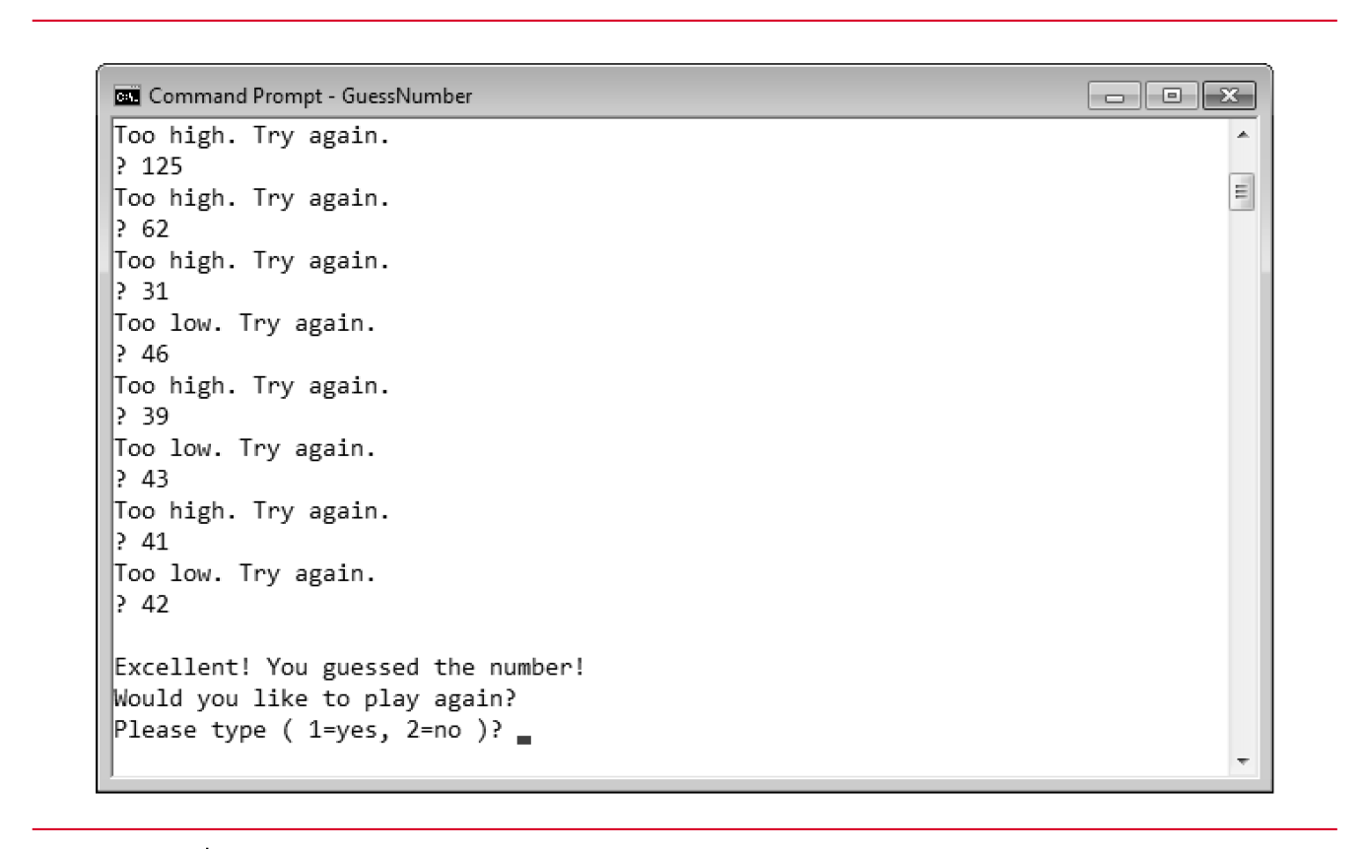
1.10.1 Running a C Application from the Windows Command Prompt (5 of 7)
Figure 1.11 Entering additional guesses and guessing the correct number.

Slide 84
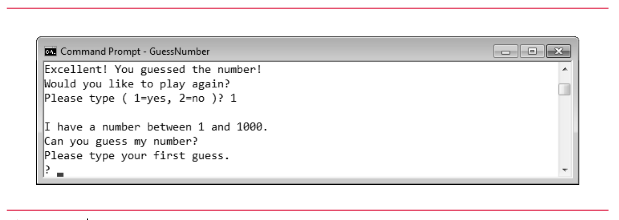
1.10.1 Running a C Application from the Windows Command Prompt (6 of 7)
Figure 1.12 Playing the game again.

Slide 85
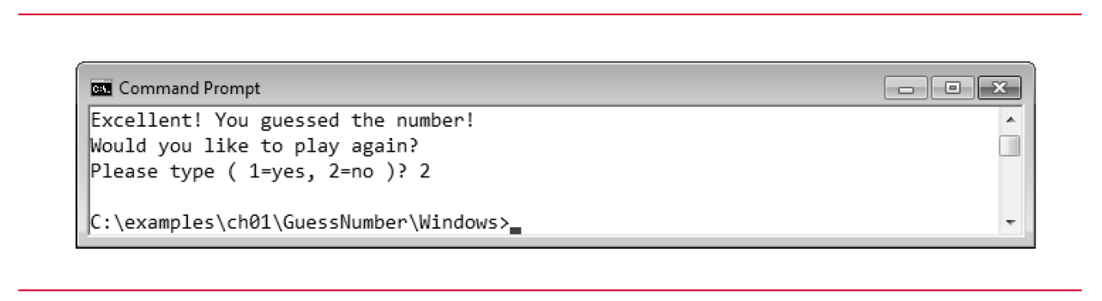
1.10.1 Running a C Application from the Windows Command Prompt (7 of 7)
Figure 1.13 Exiting the game.

Slide 86
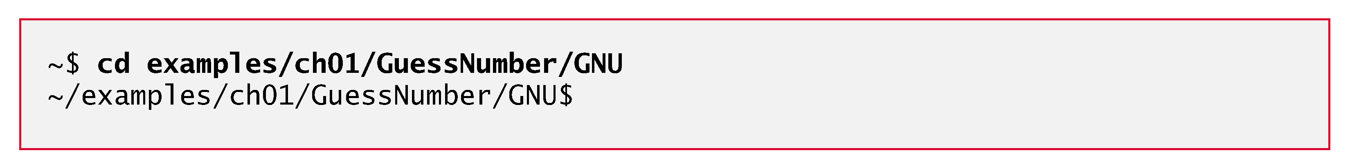
1.10.2 Running a C Application Using G N U C with Linux (1 of 8)
Figure 1.14 Changing to the GuessNumber application’s directory.

Slide 87
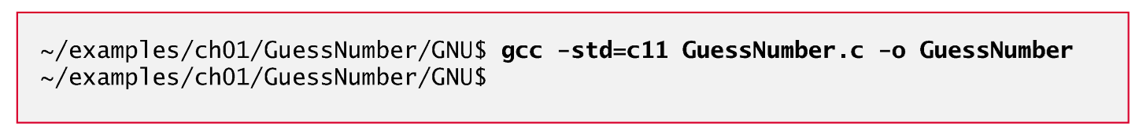
1.10.2 Running a C Application Using G N U C with Linux (2 of 8)
Figure 1.15 Compiling the GuessNumber application using the g c c command.

Slide 88
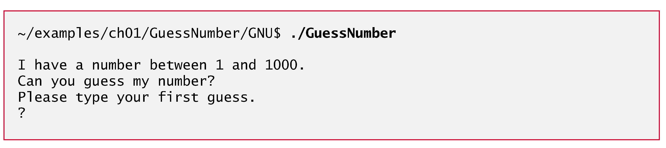
1.10.2 Running a C Application Using G N U C with Linux (3 of 8)
Figure 1.16 Running the GuessNumber application.

Slide 89
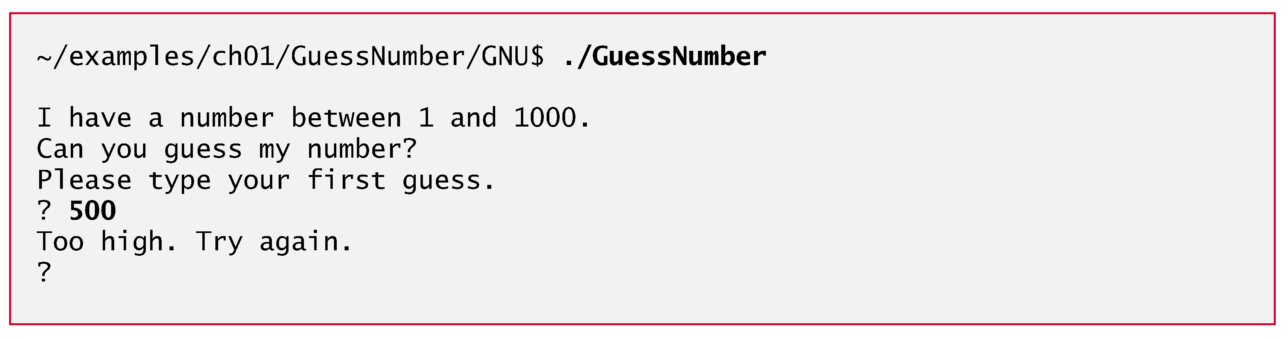
1.10.2 Running a C Application Using G N U C with Linux (4 of 8)
Figure 1.17 Entering an initial guess.

Slide 90
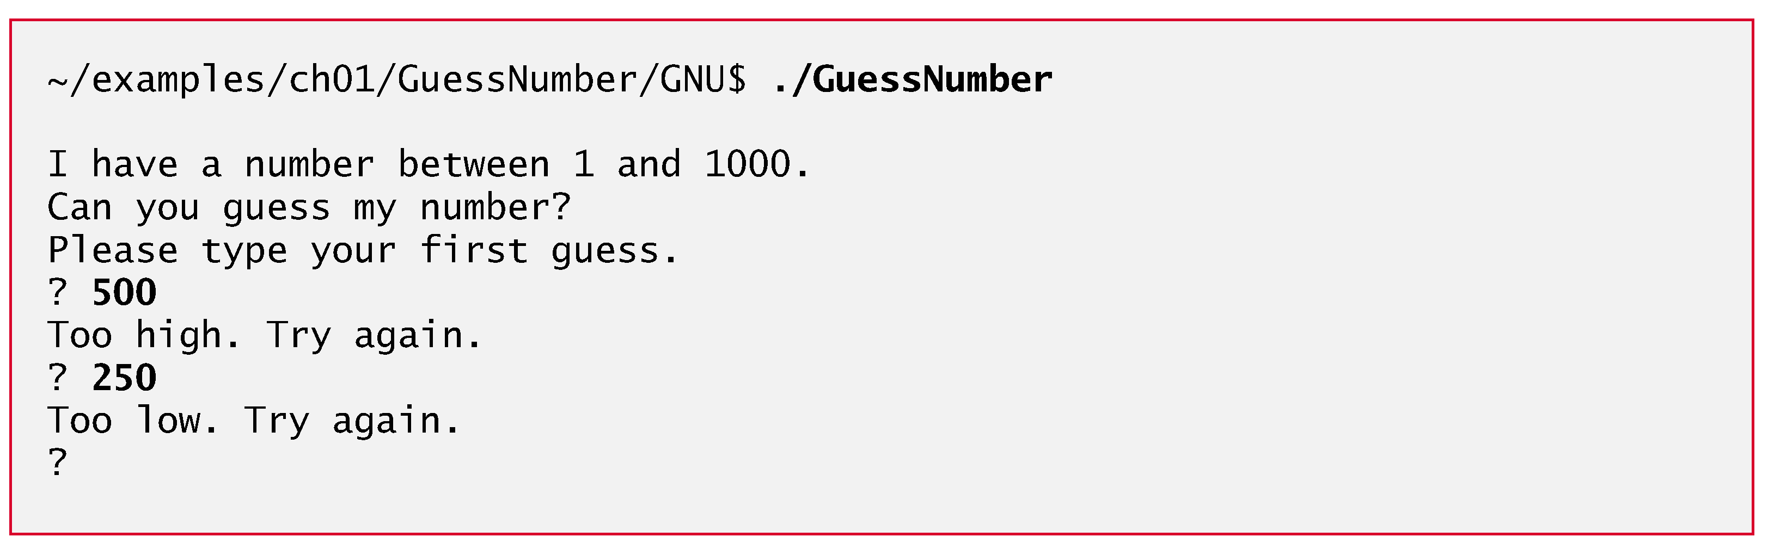
1.10.2 Running a C Application Using G N U C with Linux (5 of 8)
Figure 1.18 Entering a second guess and receiving feedback.

Slide 91
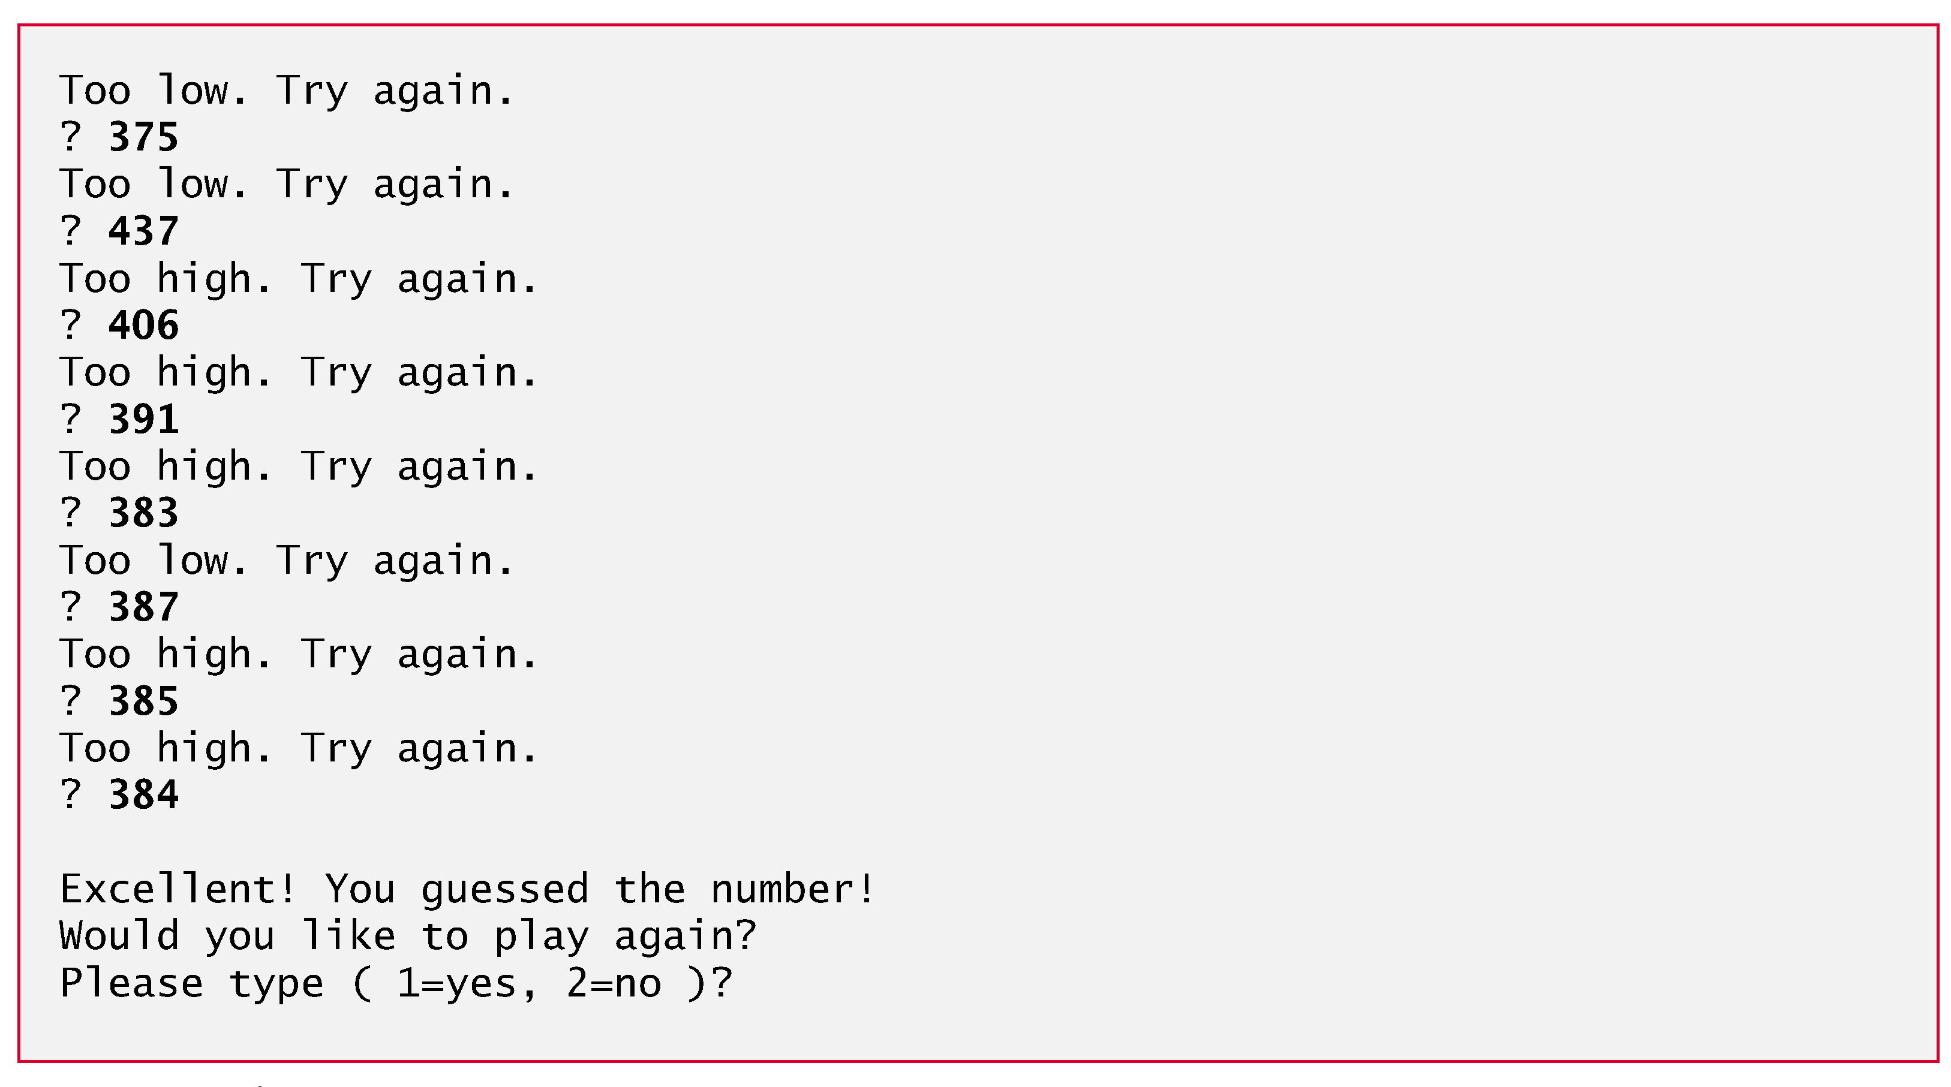
1.10.2 Running a C Application Using G N U C with Linux (6 of 8)
Figure 1.19 Entering additional guesses and guessing the correct number.

Slide 92
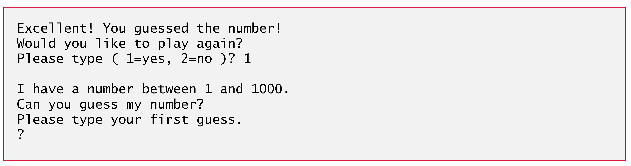
1.10.2 Running a C Application Using G N U C with Linux (7 of 8)
Figure 1.20 Playing the game again.

Slide 93
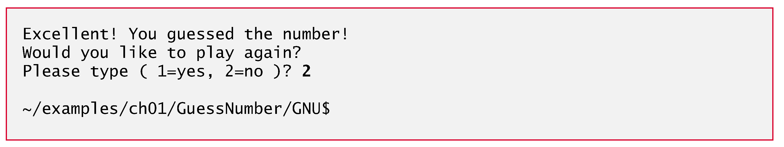
1.10.2 Running a C Application Using G N U C with Linux (8 of 8)
Figure 1.21 Exiting the game.

Slide 94
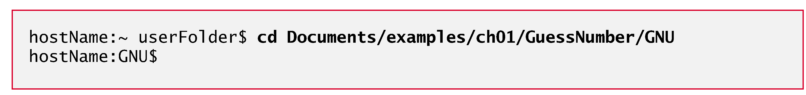
1.10.3 Running a C Application Using the Teminal on Mac O S X (1 of 8)
Figure 1.22 Changing to the GuessNumber application’s directory.

Slide 95
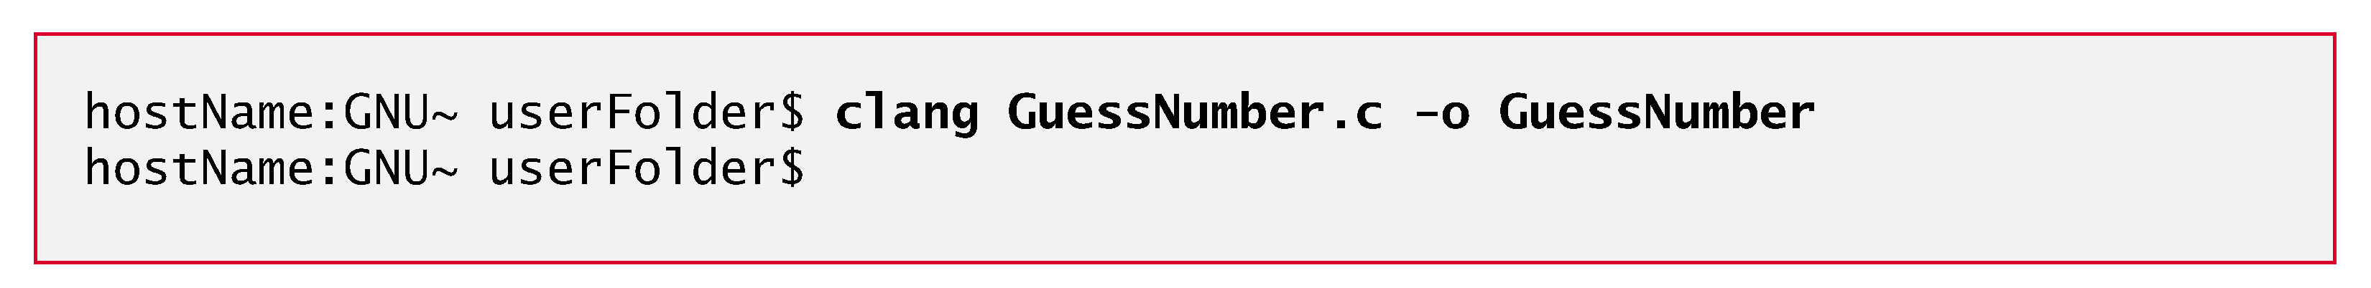
1.10.3 Running a C Application Using the Teminal on Mac O S X (2 of 8)
Figure 1.23 Compiling the GuessNumber application using the g c c command.

Slide 96
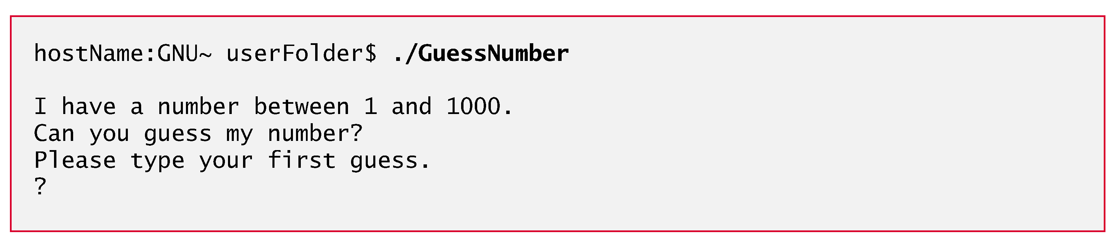
1.10.3 Running a C Application Using the Teminal on Mac O S X (3 of 8)
Figure 1.24 Running the GuessNumber application.

Slide 97
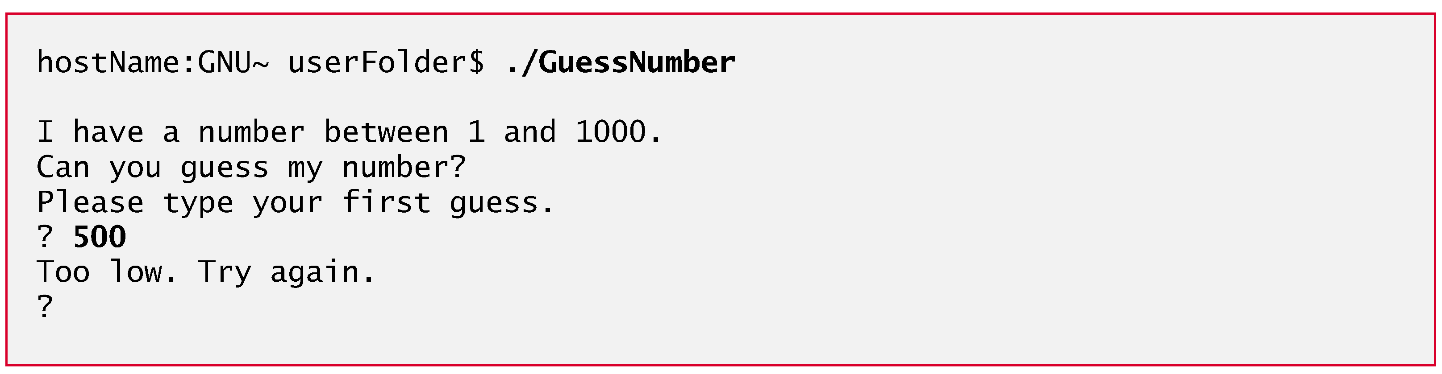
1.10.3 Running a C Application Using the Teminal on Mac O S X (4 of 8)
Figure 1.25 Entering an initial guess.

Slide 98
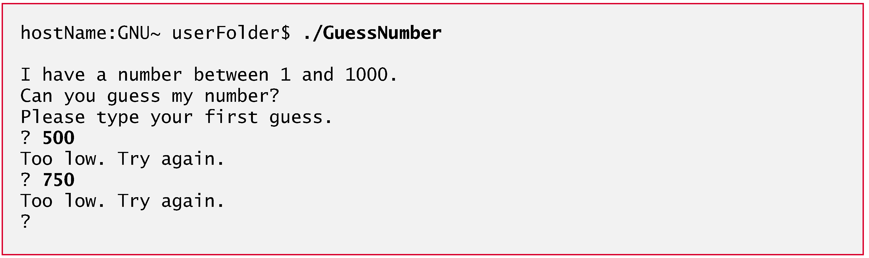
1.10.3 Running a C Application Using the Teminal on Mac O S X (5 of 8)
Figure 1.26 Entering a second guess and receiving feedback.

Slide 99
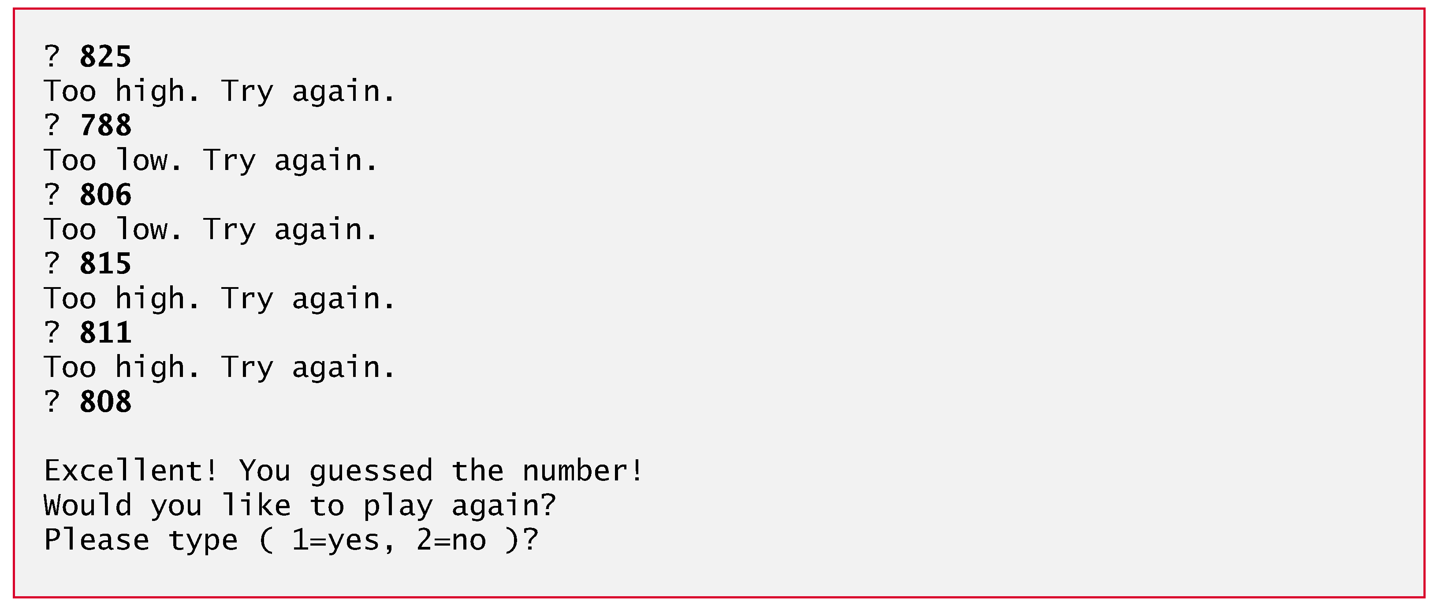
1.10.3 Running a C Application Using the Teminal on Mac O S X (6 of 8)
Figure 1.27 Entering additional guesses and guessing the correct number.

Slide 100

1.10.3 Running a C Application Using the Teminal on Mac O S X (7 of 8)
Figure 1.28 Playing the game again.

Slide 101
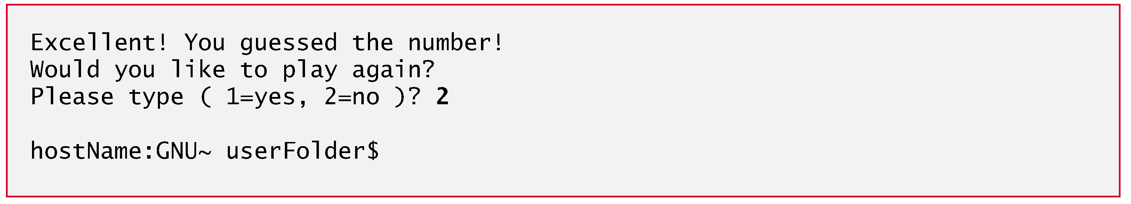
1.10.3 Running a C Application Using the Teminal on Mac O S X (8 of 8)
Figure 1.29 Exiting the game.

Slide 102
1.11 Operating Systems
Operating systems are software systems that make using computers more convenient for users, application developers and system administrators.
Operating systems provide services that allow each application to execute safely, efficiently and concurrently (i.e., in parallel) with other applications.
The software that contains the core components of the operating system is called the kernel.
Popular desktop operating systems include Linux, Windows 7 and Mac O S X.
Popular mobile operating systems used in smartphones and tablets include Google’s Android, Apple’s i O S (for iPhone, iPad and iPod Touch devices), BlackBerry O S and Windows Phone 7.

Slide 103
1.11.1 Windows—A Proprietary Operating System
In the mid-1980s, Microsoft developed the Windows operating system, consisting of a graphical user interface built on top of D O S — a nenormously popular personal-computer operating system of the time that users interacted with by typing commands.
Windows borrowed from many concepts (such as icons, menus and windows) developed by Xerox P A R C and popularized by early Apple Macintosh operating systems.
Windows is a proprietary operating system—it’s controlled by Microsoft exclusively.

Slide 104
1.11.2 Linux—An Open-Source Operating System (1 of 2)
The Linux operating system is perhaps the greatest success of the open-source movement.
Open-source software departs from the proprietary software development style that dominated software’s early years.
With open-source development, individuals and companies contribute their efforts in developing, maintaining and evolving software in exchange for the right to use that software for their own purposes, typically at no charge.
Rapid improvements to computing and communications, decreasing costs and open-source software have made it much easier and more economical to create a software-based business now than just a decade ago.
A great example is Facebook, which was launched from a college dorm room and built with open-source software.

Slide 105
1.11.2 Linux—An Open-Source Operating System (2 of 2)
The Linux kernel is the core of the most popular open-source, freely distributed, full-featured operating system.
It’s developed by a loosely organized team of volunteers and is popular in servers, personal computers and embedded systems.
Unlike that of proprietary operating systems like Microsoft’s Windows and Apple’s Mac O S X, Linux source code (the program code) is available to the public for examination and modification and is free to download and install.
Linux has become extremely popular on servers and in embedded systems, such as Google’s Android-based smartphones.

Slide 106
1.11.3 Apple’s Mac O S X; Apple’s i O S for iPhone®, iPad® and iPod Touch® Devices (1 of 2)
In 1979, Steve Jobs and several Apple employees visited Xerox P A R C (Palo Alto Research Center) to learn about Xerox’s desktop computer that featured a graphical user interface (G U I).
That G U I served as the inspiration for the Apple Macintosh, launched with much fanfare in a memorable Super Bowl ad in 1984.
The Objective-C programming language, created by Brad Cox and Tom Love at Stepstone in the early 1980s, added capabilities for object-oriented programming (O O P) to the C programming language.

Slide 107
1.11.3 Apple’s Mac O S X; Apple’s i O S for iPhone®, iPad® and iPod Touch® Devices (2 of 2)
Steve Jobs left Apple in 1985 and founded NeXT Inc. In 1988, NeXT licensed Objective-C from StepStone and developed an Objective-C compiler and libraries which were used as the platform for the NeXTSTEP operating system’s user interface and Interface Builder—used to construct graphical user interfaces.
Jobs returned to Apple in 1996 when Apple bought NeXT. Apple’s Mac O S X operating system is a descendant of NeXTSTEP.
Apple’s proprietary iPhone operating system, i O S, is derived from Apple’s Mac O S X and is used in the iPhone, iPad and iPod Touch devices.

Slide 108
1.11.4 Google’s Android
Android—the fastest growing mobile and smartphone operating system—is based on the Linux kernel and Java.
One benefit of developing Android apps is the openness of the platform. The operating system is open source and free.
The Android operating system is used in numerous smartphones, e-reader devices, tablet computers, in-store touch-screen kiosks, cars, robots, multimedia players and more.

Slide 109
1.12 The Internet and the World Wide Web (1 of 4)
The Internet—a global network of computers—was made possible by the convergence of computing and communications technologies.
In the late 1960s, A R P A (the Advanced Research Projects Agency) rolled out blueprints for networking the main computer systems of about a dozen A R P A-funded universities and research institutions.
A R P A proceeded to implement the A R P A NET, which eventually evolved into today’s Internet.
A primary goal for A R P A NET was to allow multiple users to send and receive information simultaneously over the same communications paths (e.g., phone lines).

Slide 110
1.12 The Internet and the World Wide Web (2 of 4)
T C P/I P
The protocol (i.e., set of rules) for communicating over the A R P A NET became known as T C P—theTransmission Control Protocol.
T C P ensured that messages were properly routed from sender to receiver and that they arrived intact.
As the Internet evolved, organizations worldwide were implementing their own networks. One challenge was to get these different networks to communicate.
A R P A accomplished this with the development of I P—the Internet Protocol, truly creating a network of networks, the current architecture of the Internet.
The combined set of protocols is now commonly called T C P/I P.

Slide 111
1.12 The Internet and the World Wide Web (3 of 4)
World Wide Web, H T M L, H T T P
The World Wide Web allows you to execute web-based applications and to locate and view multimedia-based documents on almost any subject over the Internet.
In 1989, Tim Berners-Lee of C E R N began to develop a technology for sharing information via hyperlinked text documents. Berners-Lee called his invention the HyperText Markup Language (H T M L).
He also wrote communication protocols to form the backbone of his new information system, which he called the World Wide Web.
In particular, he wrote the Hypertext Transfer Protocol (H T T P)—a communications protocol used to send information over the web.

Slide 112
1.12 The Internet and the World Wide Web (4 of 4)
Web Services
Web services are software components stored on one computer that can be accessed by an app (or other software component) on another computer over the Internet.
With web services, you can create mashups, which enable you to rapidly develop apps by combining complementary web services, often from multiple organizations and possibly other forms of information feeds.
Programmableweb (http://www.programmableweb.com/) provides a directory of over 11,150 A P Is and 7,300 mashups, plus how-to guides and sample code for creating your own mashups. lists some popular web services.
According to Programmableweb, the three most widely used A P I s for mashups are Google Maps, Twitter and YouTube.

Slide 113
Figure 1.30 Some Popular Web Services (1 of 2)
(http://www.programmableweb.com/category/all/apis)
Web services source | How it’s used
Google Maps | Mapping services
Twitter | Microblogging
YouTube | Video search
Facebook | Social networking
Instagram | Photo sharing
Foursquare | Mobile check-in
LinkedIn | Social networking for business
Groupon | Social commerce
Netflix | Movie rentals
eBay | Internet auctions
Wikipedia | Collaborative encyclopedia

Slide 114
Figure 1.30 Some Popular Web Services (2 of 2)
Web services source | How it’s used
PayPal | Payments
Last.fm | Internet radio
Amazon eCommerce | Shopping for books and lots of other products
Salesforce.com | Customer Relationship Management (C R M)
Skype | Internet telephony
Microsoft Bing | Search
Flickr | Photo sharing
Zillow | Real-estate pricing
Yahoo Search | Search
WeatherBug | Weather

Slide 115
Figure 1.31 Web Services Directories
Directory | U R L
ProgrammableWeb | www.programmableweb.com
Google Code API Directory | code.google.com/apis/gdata/docs/directory.html

Slide 116
Figure 1.32 A Few Popular Web Mashups
U R L | Description
http://twikle.com/ | Twikle uses Twitter web services to aggregate popular news stories being shared online.
http://trendsmap.com/ | TrendsMap uses Twitter and Google Maps. It allows you to track tweets by location and view them on a map in real time.
http://www.coindesk.com/price/ bitcoin-price-ticker-widget/ | The Bitcoin Price Ticker Widget uses CoinDesk’s APIs to display the real-time Bitcoin price, the day’s high and low prices and a graph of the price fluctuations over the last sixty minutes.
http://www.dutranslation.com/ | The Double Translation mashup allows you to use Bing and Google translation services simultaneously to translate text to and from over 50 languages. You can then compare the results between the two.
http://musicupdated.com/ | Music Updated uses Last.fm and YouTube web services. Use it to track album releases, concert information and more for your favorite artists.

Slide 117
1.13 Some Key Software Development Terminology
Figure 1.33 lists a number of buzzwords that you’ll hear in the software development community.

Slide 118
Figure 1.33 Software Technologies (1 of 4)
Technology | Description
Agile software development | Agile software development is a set of methodologies that try to get software implemented faster and using fewer resources. Check out the Agile Alliance (www.agilealliance.org) and the Agile Manifesto (www.agilemanifesto.org).
Refactoring | Refactoring involves reworking programs to make them clearer and easier to maintain while preserving their correctness and functionality. It’s widely employed with agile development methodologies. Many I D E s contain built-in refactoring tools to do major portions of the reworking automatically.
Design patterns | Design patterns are proven architectures for constructing flexible and maintainable object-oriented software. The field of design patterns tries to enumerate those recurring patterns, encouraging software designers to reuse them to develop better-quality software using less time, money and effort.

Slide 119
Figure 1.33 Software Technologies (2 of 4)
Technology | Description
Lamp | Lamp is an acronym for the open-source technologies that many developers use to build web applications inexpensively—it stands for Linux, Apache, My S Q L and P H P (or Perl or Python—two other popular scripting languages). My S Q L is an open-source database-management system. P H P is the most popular open-source server-side “scripting” language for developing web applications. Apache is the most popular web server software. The equivalent for Windows development is W A M P—Windows, Apache, My S Q L and P H P.

Slide 120
Figure 1.33 Software Technologies (3 of 4)
Technology | Description
Software as a Service (S a a S) | Software has generally been viewed as a product; most software still is offered this way. If you want to run an application, you buy a software package from a software vendor—often a C D, D V D or web download. You then install that software on your computer and run it as needed. As new versions appear, you upgrade your software, often at considerable cost in time and money. This process can become cumbersome for organizations that must maintain tens of thousands of systems on a diverse array of computer equipment. With Software as a Service (S a a S), the software runs on servers elsewhere on the Internet. When that server is updated, all clients worldwide see the new capabilities—no local installation is needed. You access the service through a browser. Browsers are quite portable, so you can run the same applications on a wide variety of computers from anywhere in the world. Salesforce.com, Google, and Microsoft’s Office Live and Windows Live all offer S a a S.

Slide 121
Figure 1.33 Software Technologies (4 of 4)
Technology | Description
Platform as a Service (P a a S) | Platform as a Service (P a a S) provides a computing platform for developing and running applications as a service over the web, rather than installing the tools on your computer. Some PaaS providers are Google App Engine, Amazon E C2 and Windows Azure™.
Cloud computing | SaaS and PaaS are examples of cloud computing. You can use software and data stored in the “cloud”—i.e., accessed on remote computers (or servers) via the Internet and available on demand—rather than having it stored locally on your desktop, notebook computer or mobile device. This allows you to increase or decrease computing resources to meet your needs at any given time, which is more cost effective than purchasing hardware to provide enough storage and processing power to meet occasional peak demands. Cloud computing also saves money by shifting to the service provider the burden of managing these apps (such as installing and upgrading the software, security, backups and disaster recovery).
Software Development Kit (S D K) | Software Development Kits (S D Ks) include the tools and documentation developers use to program applications.

Slide 122
Figure 1.34 Software Product-Release Terminology (1 of 2)
Version | Description
Alpha | Alpha software is the earliest release of a software product that’s still under active development. Alpha versions are often buggy, incomplete and unstable and are released to a relatively small number of developers for testing new features, getting early feedback, etc.
Beta | Beta versions are released to a larger number of developers later in the development process after most major bugs have been fixed and new features are nearly complete. Beta software is more stable, but still subject to change.
Release candidates | Release candidates are generally feature complete, (mostly) bug free and ready for use by the community, which provides a diverse testing environment—the software is used on different systems, with varying constraints and for a variety of purposes.

Slide 123
Figure 1.34 Software Product-Release Terminology (2 of 2)
Version | Description
Final release | Any bugs that appear in the release candidate are corrected, and eventually the final product is released to the general public. Software companies often distribute incremental updates over the Internet.
Continuous beta | Software that’s developed using this approach (for example, Google search or Gmail) generally does not have version numbers. It’s hosted in the cloud (not installed on your computer) and is constantly evolving so that users always have the latest version.

Slide 124
1.14 Keeping Up-To-Date with Information Technologies
Figure 1.35 lists key technical and business publications that will help you stay up-to-date with the latest news and trends and technology. You can also find a growing list of Internet-and web-related Resource Centers at www.deitel.com/ResourceCenters.html.

Slide 125
Figure 1.35 Technical and Business Publications (1 of 2)
Publication | U R L
AllThingsD | allthingsd.com
Bloomberg BusinessWeek | www.businessweek.com
C N E T | news.cnet.com
Communications of the A C M | cacm.acm.org
Computerworld | www.computerworld.com
Engadget | www.engadget.com
eWeek | www.eweek.com
Fast Company | www.fastcompany.com
Fortune | money.cnn.com/magazines/fortune
GigaO M | gigaom.com
Hacker News | news.ycombinator.com

Slide 126
Figure 1.35 Technical and Business Publications (2 of 2)
Publication | U R L
I E E E Computer Magazine | www.computer.org/portal/web/computingnow/computer
InfoWorld | www.infoworld.com
Mashable | mashable.com
P C World | www.pcworld.com
S D Times | www.sdtimes.com
Slashdot | slashdot.org
Stack Overflow | stackoverflow.com
Technology Review | technologyreview.com
Techcrunch | techcrunch.com
The Next Web | thenextweb.com
The Verge | www.theverge.com
Wired | www.wired.com

Slide 127

Copyright

